Slide 1
HYPOTHESIS TESTING USING BINOMIAL DISTRIBUTION, POISSON DISTRIBUTION
Prepared By
Apil Adhikari(22/077)
Dharnidhar Thakur(23/077)

Slide 2
Binomial Distribution
A binomial distribution can be thought of as simply the probability of a SUCCESS or FAILURE outcome in an experiment or survey that is repeated multiple times.
The binomial is a type of distribution that has two possible outcomes (the prefix “bi” means two, or twice).
For example, a coin toss has only two possible outcomes: heads or tails and taking a test could have two possible outcomes: pass or fail.

Slide 3
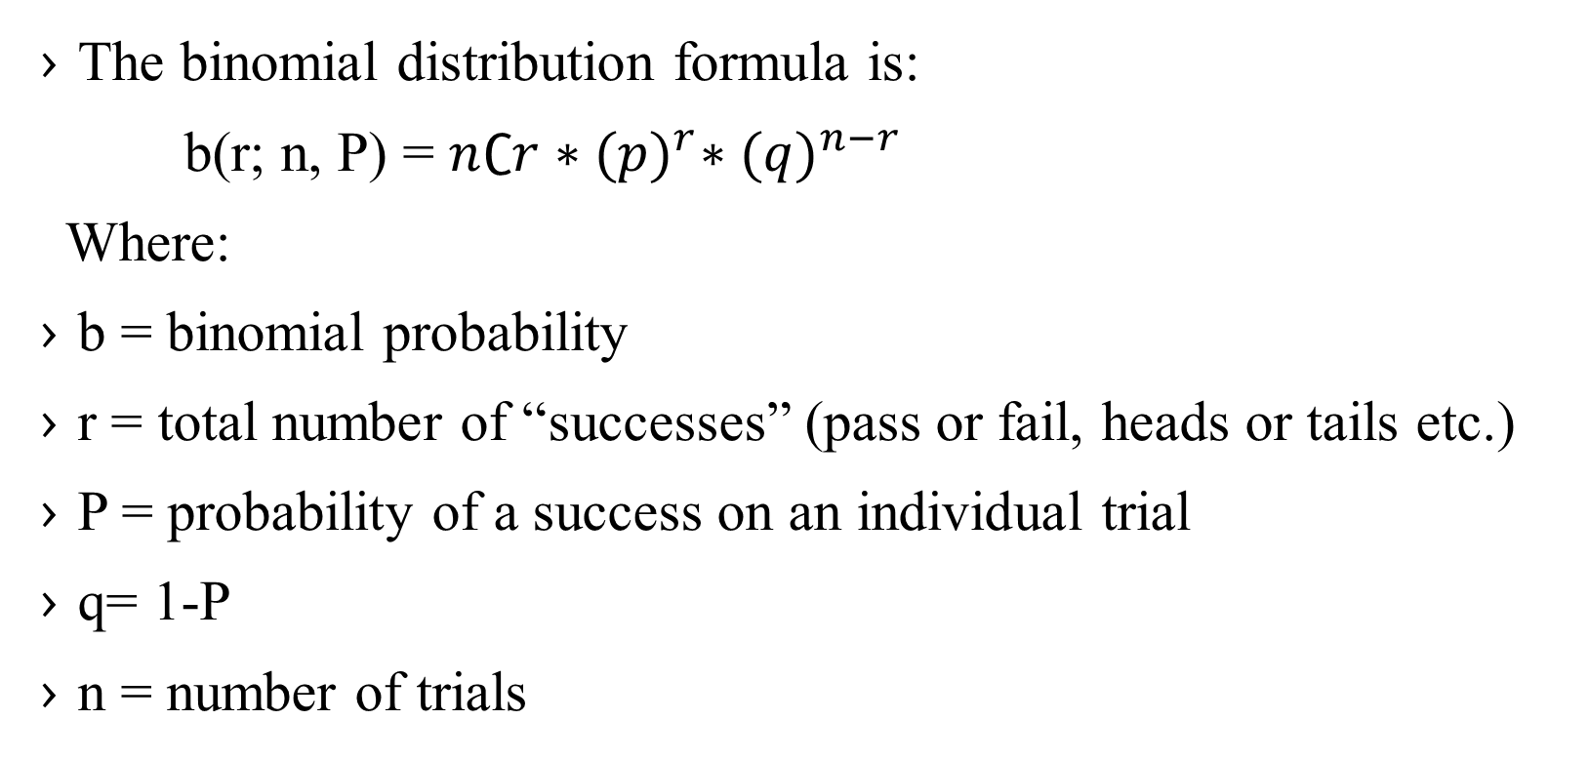
Binomial Distribution
The binomial distribution formula is:
b(r; n, P) = $n∁r∗{(p)}^{r}∗{(q)}^{n−r}$
Where:
b = binomial probability
r = total number of “successes” (pass or fail, heads or tails etc.)
P = probability of a success on an individual trial
q= 1-P
n = number of trials

Slide 4
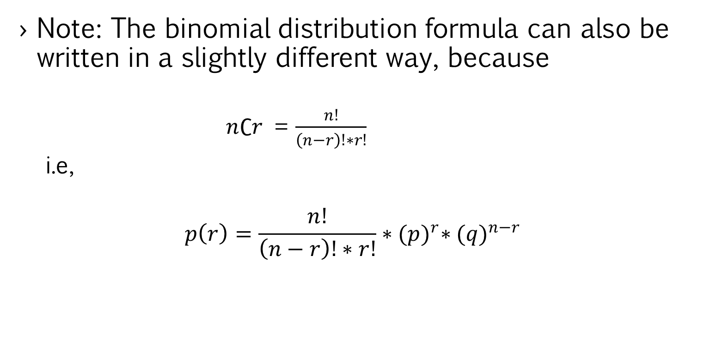
Binomial Distribution
Note: The binomial distribution formula can also be written in a slightly different way, because
$n∁r$ = $\frac{n!}{\left(n−r\right)!∗r!}$
i.e,
$$p\left(r\right)=\frac{n!}{\left(n−r\right)!∗r!}∗{(p)}^{r}∗{(q)}^{n−r}$$

Slide 5
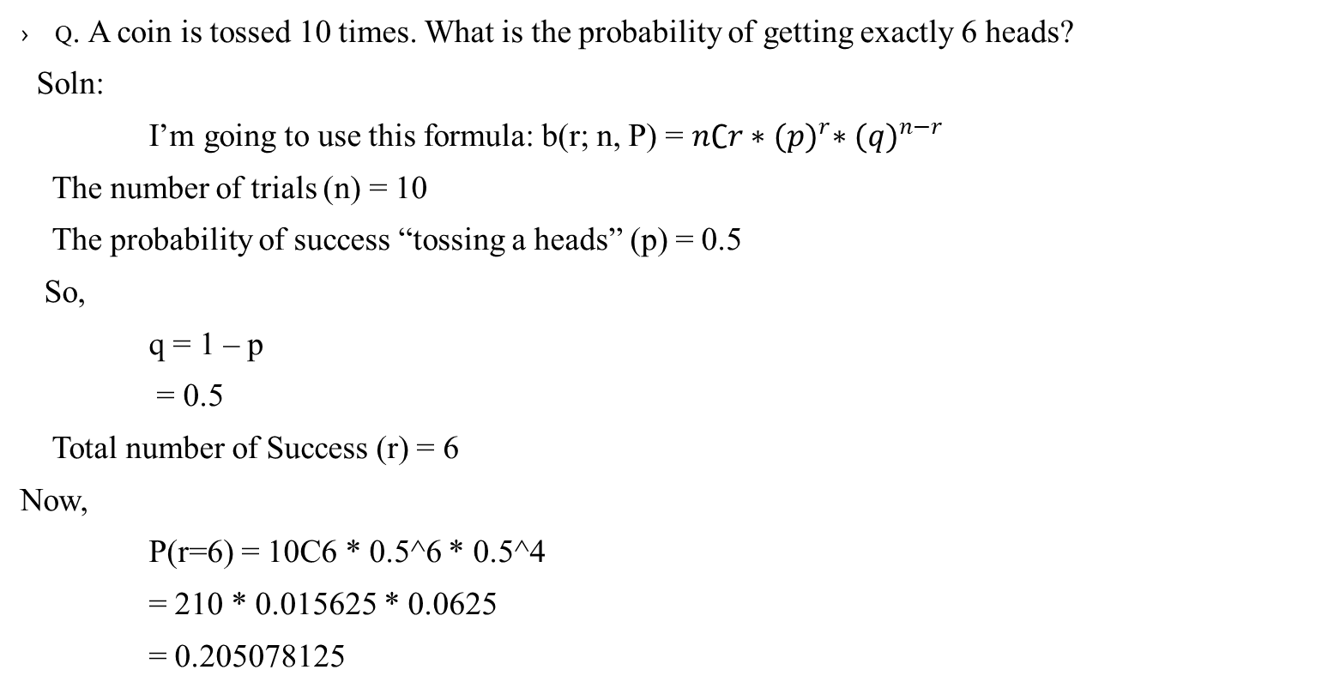
Binomial Distribution Example
Q. A coin is tossed 10 times. What is the probability of getting exactly 6 heads?
Soln:
I’m going to use this formula: b(r; n, P) = $n∁r∗{(p)}^{r}∗{(q)}^{n−r}$
The number of trials (n) = 10
The probability of success “tossing a heads” (p) = 0.5
So,
q = 1 – p
= 0.5
Total number of Success (r) = 6
Now,
P(r=6) = 10C6 * 0.5^6 * 0.5^4
= 210 * 0.015625 * 0.0625
= 0.205078125

Slide 6
Hypothesis test with the Binomial Distribution
whenever we want to do hypothesis testing, we first define our hypotheses and decide upon an error level.
we must calculate the probability, p, of the observed event and any more extreme event happening. We compare this to the level of significance α.
If p>α then we accept the null hypothesis.
If p<α we accept the alternative hypothesis

Slide 7
Hypothesis test with the Binomial Distribution
For Example :-
Q) A coin is tossed twenty times, landing on heads six times. Perform a hypothesis test at a 5% significance level to see if the coin is biased
Soln;
First, we need to write down the null and alternative hypotheses. In this case
H0: The coin is not biased.
H1: The coin is biased in favour of tails.

Slide 8
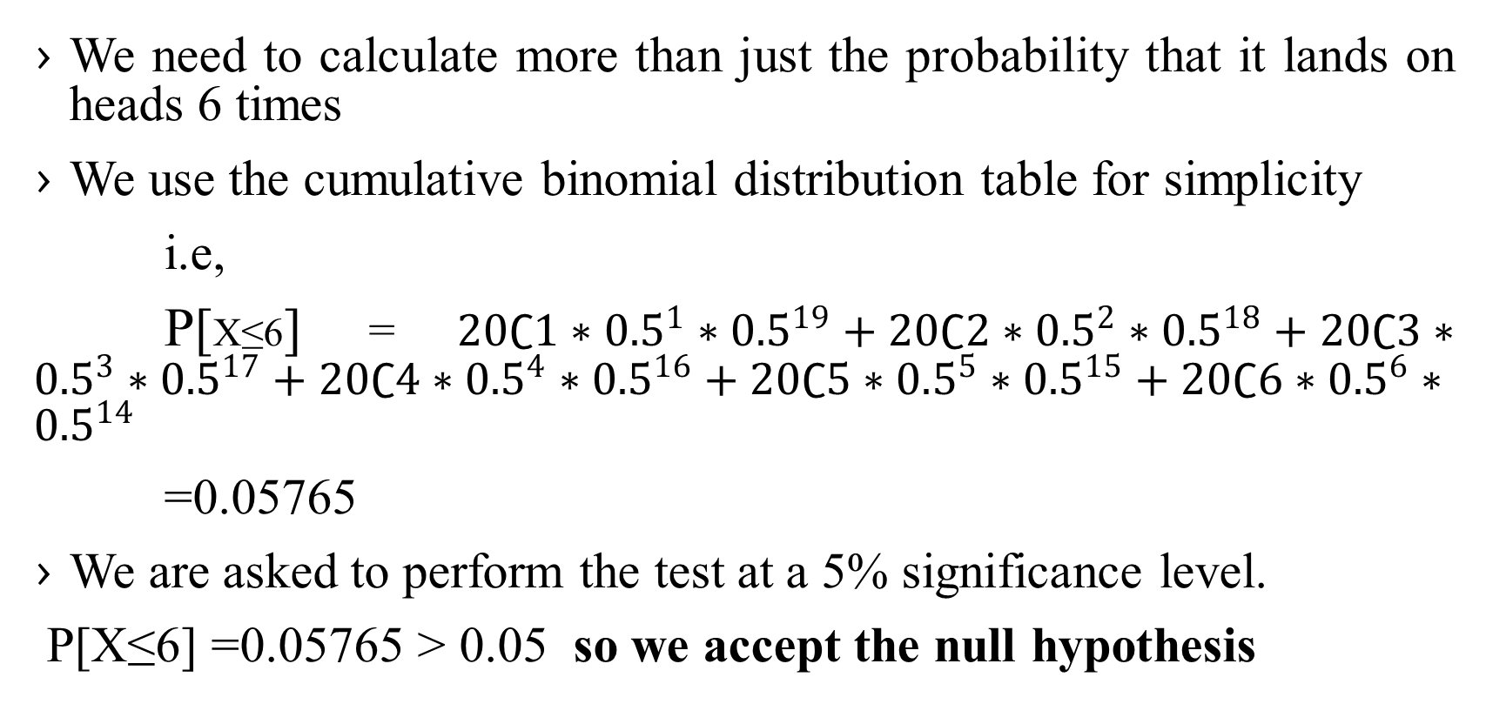
Hypothesis test with the Binomial Distribution
We need to calculate more than just the probability that it lands on heads 6 times
We use the cumulative binomial distribution table for simplicity
i.e,
P[X≤6] = $20∁1∗{0.5}^{1}∗{0.5}^{19}+20∁2∗{0.5}^{2}∗{0.5}^{18}+20∁3∗{0.5}^{3}∗{0.5}^{17}+20∁4∗{0.5}^{4}∗{0.5}^{16}+20∁5∗{0.5}^{5}∗{0.5}^{15}+20∁6∗{0.5}^{6}∗{0.5}^{14}$
=0.05765
We are asked to perform the test at a 5% significance level.
P[X≤6] =0.05765 > 0.05 so we accept the null hypothesis

Slide 9
Hypothesis test with the Binomial Distribution
But what if the coin had landed on heads just 5 times?
for P[X≤5] = 0.021
P[X≤5]=0.021<0.05 ,so reject the null hypothesis and accept the alternative hypothesis.
So the point at which we switch from accepting the null hypothesis to rejecting it is when we obtain 5 heads.
This means that 5 is the Critical Value

Slide 10
Any Query??
Thank You

